Slide 1
Pothole Detection-POC Using AI

Slide 2
Content
Data Import
Problem Statement
Scope and Objectives
What Is Pothole?
What is impact in human life from Pothole?
Pothole Detection Classification Challenges
Benefits Of Pothole Detection
Classification

Slide 3
Content
Benefits of Pothole Classification for Roads
Tips to Minimize Pothole Damage
What is a car sensor?
Reducing Accident And Save Human Life
Research Method
Methodology
Software Requirements

Slide 4
Data Import
Data import is a critical component of many business processes, including data migration, data integration, and data warehousing.
Once the image data has been imported, it can be processed or analyzed using various techniques, such as image recognition, computer vision, or deep learning algorithms. These techniques enable you to extract meaningful information from images, such as identifying objects or patterns, detecting anomalies, or predicting outcomes.
In our POC related we are strong our data in Azure data lake GEN2.

Slide 5
Problem Statement
Potholes have been a difficult issue and have become a danger for safe street travel, so as to beat the issue we are proposing this framework utilizing Machine Learning and Image Processing. which will recognize the potholes and by doing so we can proficiently handle the issue.
According to the data shared by states with the Centre, Uttar Pradesh, India recorded the highest number of pothole deaths at 987.
In Maharashtra, the number of deaths (726) had nearly doubled.
As per official statistics, potholes claimed 11,836 lives and left 36,421 persons injured in India from 2013 to 2016.

Slide 6
Scope and Objectives
Potholes are a heavy issue and became a threat to safe road travel, so as to beat the problem we are proposing this technique using machine learning and image processing, which can detect the potholes and by doing so we will efficiently tackle the difficulty.
Better road safety: Machines aren’t at risk of human error and distractions, resulting in swift and appropriate responses in real-time road conditions.
Reduced commute time: With vehicles communicating through one another.

Slide 7
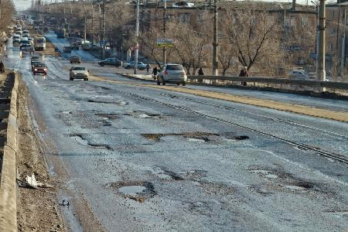
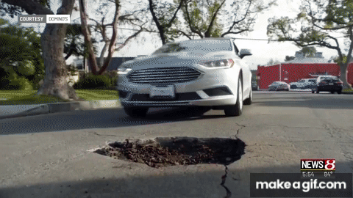
What Is Pothole?
A pothole is a type of road surface damage that occurs when the pavement or asphalt on a road surface deteriorates due to the effects of weather, traffic, age and poor road construction or maintenance. Potholes are typically circular or oval-shaped holes in the road, ranging in size from small depressions to larger cavities.

Slide 8
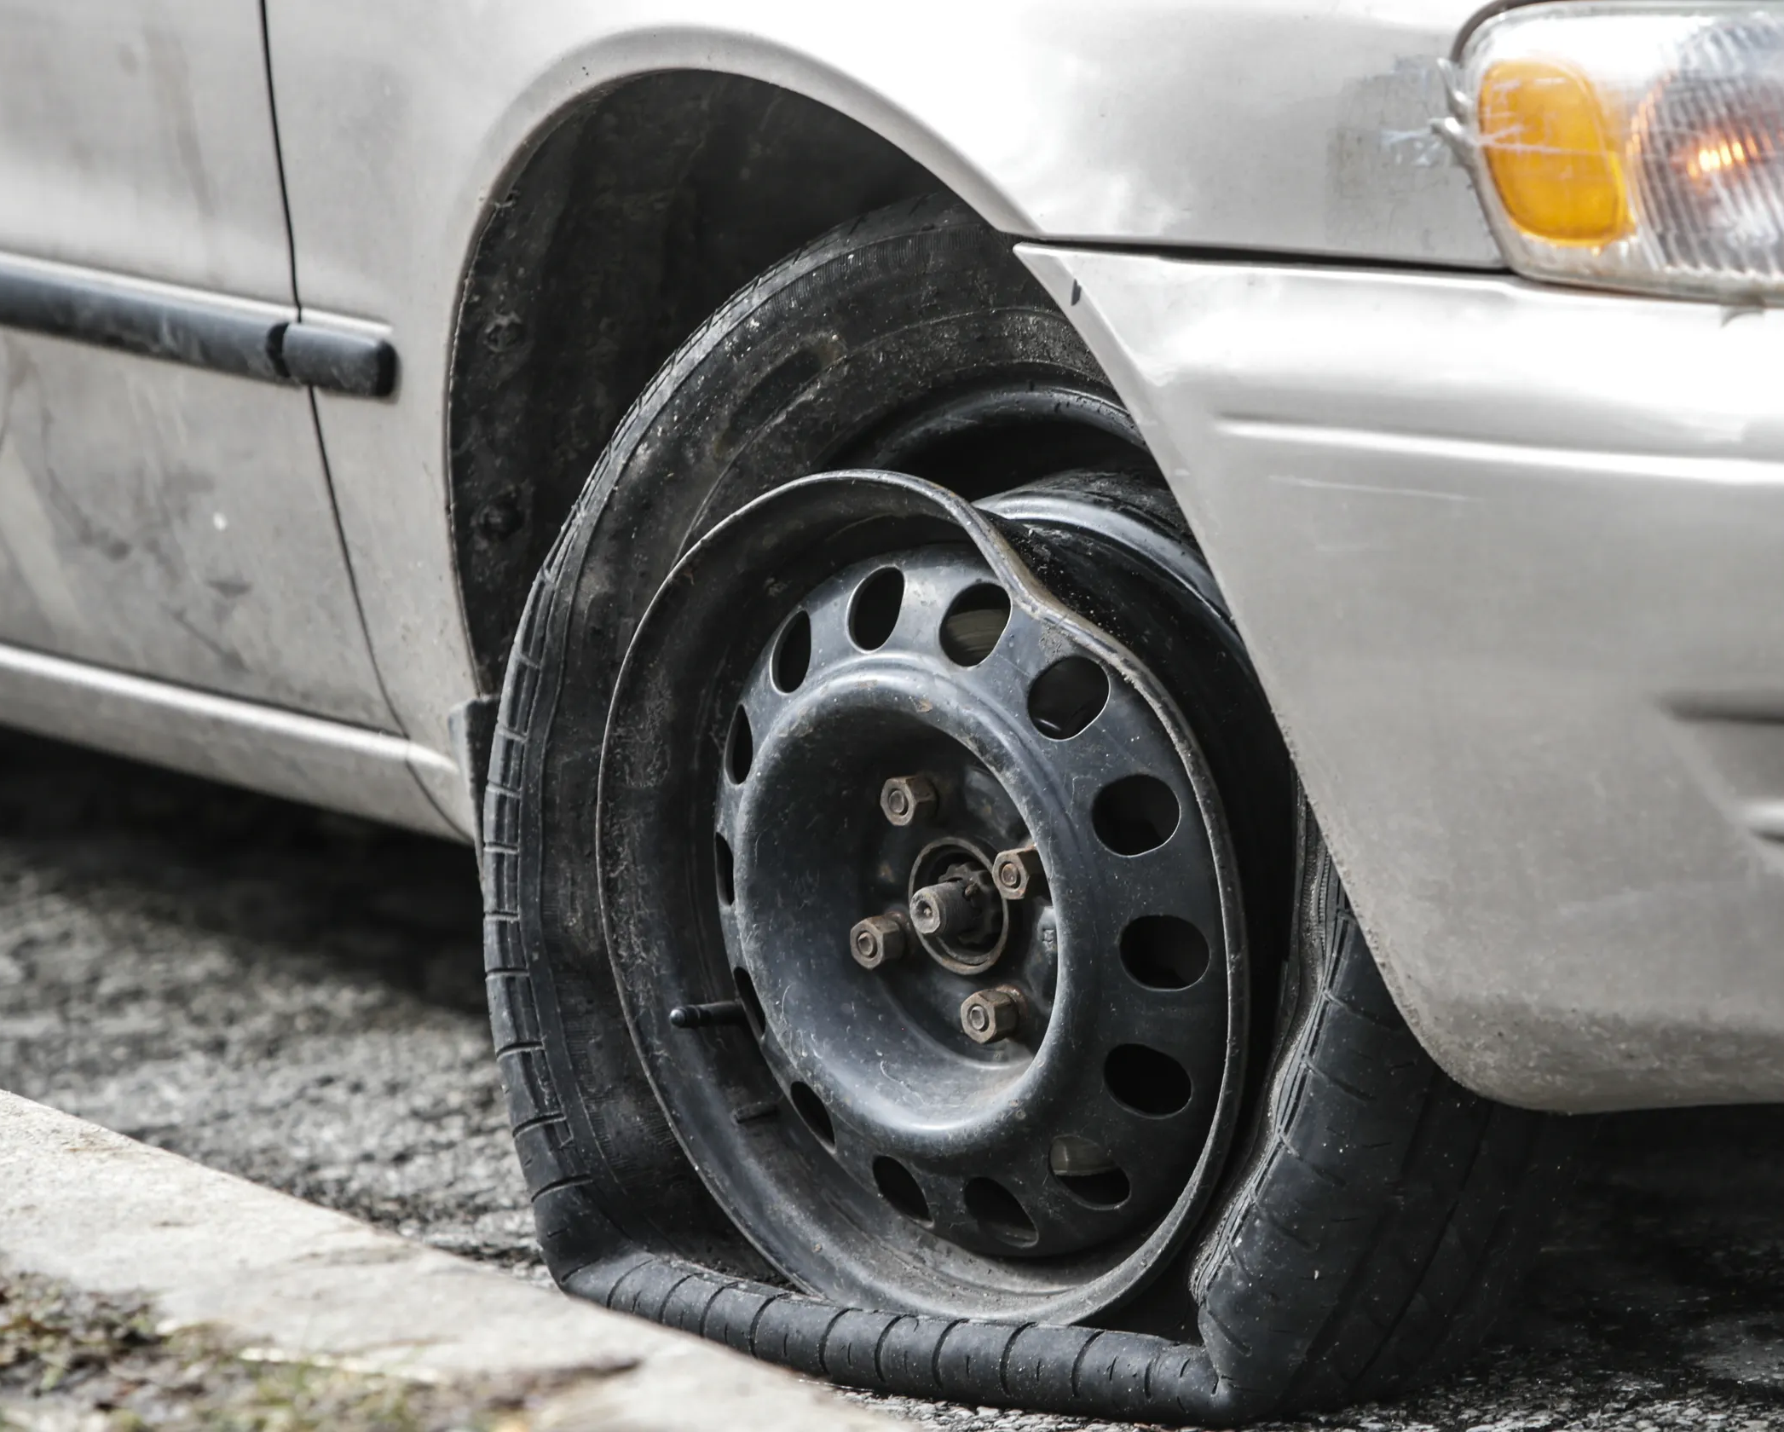
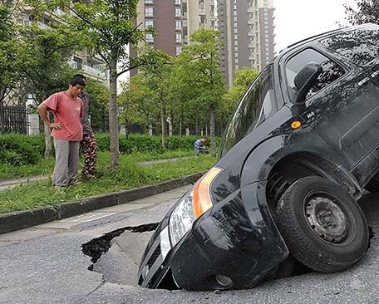
What is impact in human life from Pothole?
They can pose a significant hazard to drivers, as hitting a pothole can cause damage to tires, wheels, and suspensions, even result in accidents and loses of human life (Deaths).

Slide 9
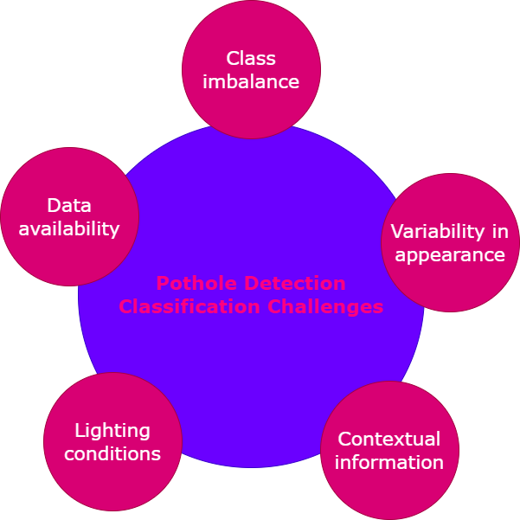
Pothole Detection Classification Challenges Some of the classification challenges associated with pothole detection include

Slide 10
Pothole Detection Classification Challenges
Class imbalance: Potholes are relatively rare compared to other objects in the environment, which can result in a class imbalance problem. This means that the model may become biased towards the majority class and struggle to identify potholes accurately.
Variability in appearance: Potholes can have different appearances depending on their size, shape, depth, and location. They can also be partially obscured by shadows, debris, or other objects. This variability can make it difficult for a model to learn to recognize potholes reliably.
Contextual information: Potholes are often located in roads or parking lots, which can contain a wide variety of objects and structures. The presence of these objects can provide contextual information that can help identify potholes, but it can also introduce confusion and make it difficult for the model to focus on the potholes themselves.

Slide 11
Pothole Detection Classification Challenges
Lighting conditions: Lighting conditions can affect the appearance of potholes, making them more or less visible depending on the time of day and weather conditions. This variability can make it difficult for a model to generalize across different lighting conditions.
Data availability: Collecting labeled data for pothole detection can be challenging, especially if the potholes are rare or difficult to access. This can limit the amount and quality of data available for training and evaluation, which can in turn affect the performance of the model.

Slide 12
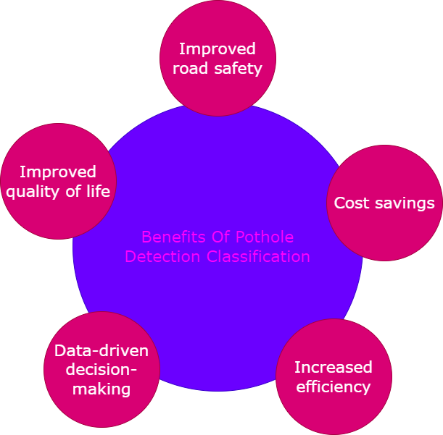
Benefits Of Pothole Detection Classification

Slide 13
Benefits Of Pothole Detection Classification
Improved road safety: Pothole detection classification can help identify and locate potholes on roads and highways, which can be hazardous to drivers, cyclists, and pedestrians. By alerting road maintenance crews to the presence of potholes, pothole detection classification can help reduce the risk of accidents and injuries.
Cost savings: Pothole detection classification can help road maintenance crews prioritize and schedule repairs more efficiently, which can reduce the overall cost of road maintenance. By identifying potholes before they become larger and more costly to repair, pothole detection classification can also help extend the lifespan of roads and highways.
Increased efficiency: Pothole detection classification can help automate the process of identifying and locating potholes, which can save time and resources compared to manual inspections. By using computer vision techniques to analyze images and videos, pothole detection classification can also identify potholes that might be difficult or dangerous for humans to detect.

Slide 14
Pothole Detection Classification Challenges
Data-driven decision-making: Pothole detection classification can generate data on the location, size, and severity of potholes, which can be used to make data-driven decisions about road maintenance and repair. By analyzing this data over time, road maintenance crews can identify trends and patterns in pothole formation and prioritize preventative maintenance strategies.
Improved quality of life: Pothole detection classification can help improve the quality of life for residents and visitors by reducing the inconvenience and discomfort associated with driving on pothole-ridden roads. By improving road conditions, pothole detection classification can also support economic development and tourism in the surrounding areas.

Slide 15
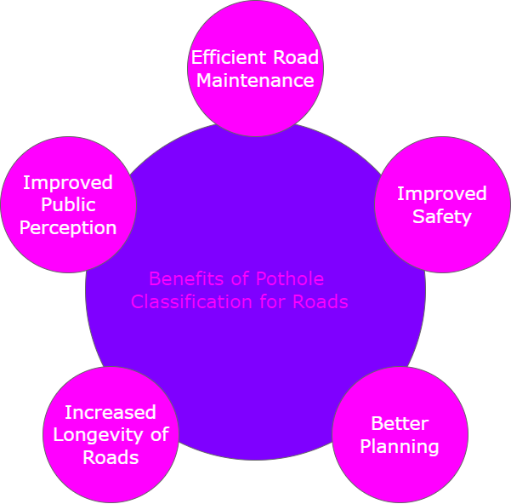
Benefits of Pothole Classification for Roads

Slide 16
Benefits of Pothole Classification for Roads
Efficient Road Maintenance: By identifying and classifying potholes, road maintenance crews can prioritize repairs based on the severity of the potholes. This can help to reduce the time and cost required for repairs and improve the overall efficiency of road maintenance.
Improved Safety: Potholes can be hazardous for drivers, cyclists, and pedestrians. Classifying potholes can help identify high-risk areas and prioritize repairs to ensure the safety of road users.
Better Planning: Classifying potholes can provide valuable data that can be used for planning and budgeting purposes. Road authorities can use this data to identify areas that require more frequent maintenance and allocate resources accordingly.

Slide 17
Benefits of Pothole Classification for Roads
Increased Longevity of Roads: Regular maintenance and repairs can help to extend the life of roads. By identifying and classifying potholes, road authorities can address small issues before they become larger, more costly problems that require full-scale road reconstruction.
Improved Public Perception: Well-maintained roads can improve the overall perception of a city or region. By addressing potholes and other road maintenance issues in a timely and efficient manner, road authorities can demonstrate their commitment to maintaining safe, reliable roads for their communities.

Slide 18
Tips to Minimize Pothole Damage
With summer and winter weather throughout the West impacting our roads, potholes are going to happen. Here’s what you can do to minimize the damage and possibly avoid these hazards.
Always drive on tires that are properly inflated and in good condition. This will give you the best chance of absorbing the impact safely.
Drive defensively. Slow down when you’re on an unfamiliar or rough road, and avoid distracted driving.
Be alert to what’s ahead, and make sure you keep enough distance between you and the vehicle in front of you so you can avoid issues.
Recognize that though you might miss the first pothole, there may be another waiting.

Slide 19
Types of car sensors The below table denotes different types of sensors in a car and their functions.
Sensor | Function
Air-flow sensor | It measures the density and volume of the air entering the combustion chamber.
Engine speed sensor | It monitors the spinning speed and position of the crankshaft.
Temperature sensor | It monitors the engine temperature.
Fuel temperature sensor | It monitors the temperature of the fuel entering the engine.
Speed sensor | It measures the speed of the wheels.
Parking sensor | It recognizes any obstacle present in the front or rear of the vehicle.

Slide 20
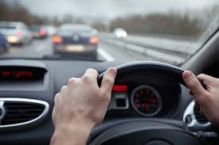

Reducing Accident And Save Human Life
pothole detection technology can help reduce accidents and save human lives by enabling early detection, creating warning systems, improving road maintenance, and informing better infrastructure planning.
Human life is prices less Reducing accident then reducing death rate.

Slide 21
Research Method
The research method for the project involves three main parts-data collections, training, and detection. The proposed vehicle and pothole detection technique detects vehicles and potholes in images with the transfer learning technique. Faster R-CNN and inception VGG16 models are the techniques used in the proposed model. The ultimate benefit of this proposed method is the least time for training along with very high accuracy.

Slide 22
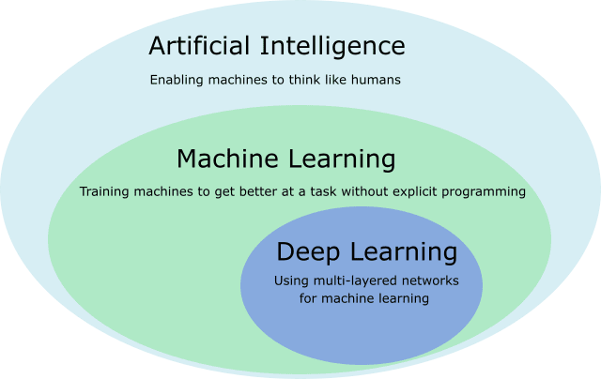
Methodology
Deep Learning:
Deep learning is a subset of machine learning that uses artificial neural networks to learn from large amounts of data. It is a type of artificial intelligence (AI) technique that enables machines to learn and make decisions in a way that mimics the human brain

Slide 23
Methodology
Custom Vision:
Custom Vision is a cloud-based machine learning tool provided by Microsoft that allows developers and data scientists to build and train custom image classification and object detection models. Custom Vision can be used for a variety of applications, including:
Product recognition
Quality control
Security
Medical imaging
Custom Vision uses a deep learning algorithm called a convolutional neural network (CNN) to process and classify images. The user provides the tool with a set of labeled images, and Custom Vision automatically generates a CNN model based on the provided data.

Slide 24
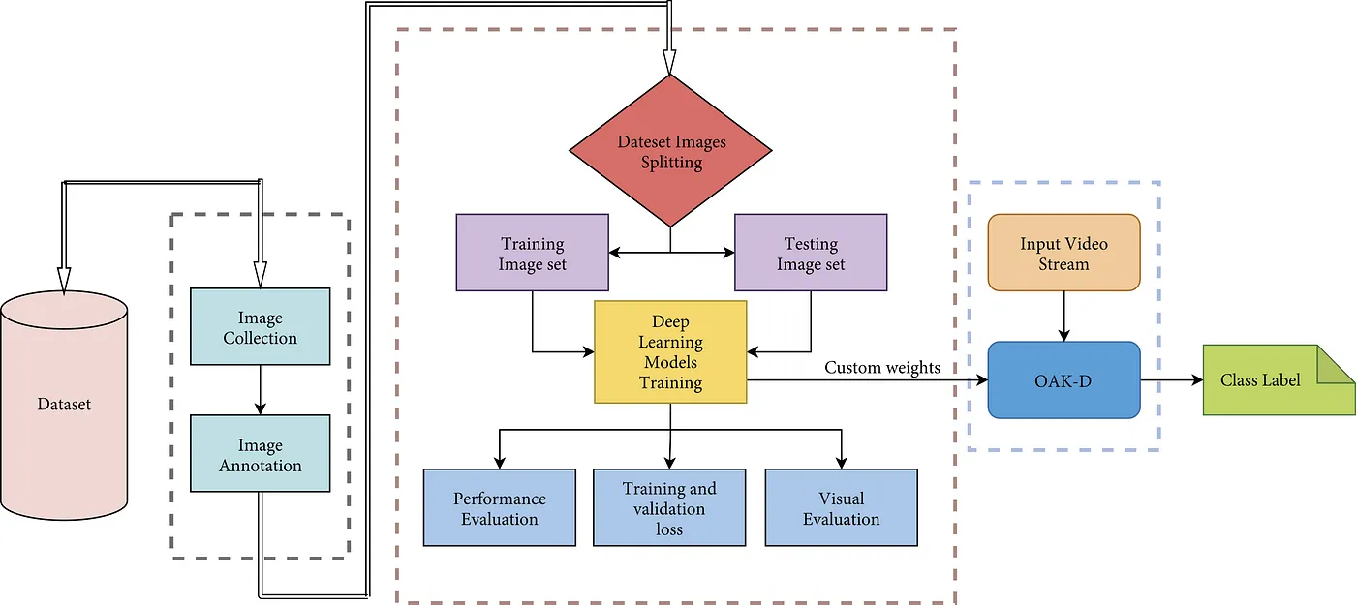
Model workflow

Slide 25
Methodology
Steps In Custom Vision :
Data Collection
Data Labeling
Model Training
Model validation
Model Evaluation
Model Deployment
Iterative Improvement

Slide 26
Working and Implementation
In this proposed scheme, a camera module will be capturing the Pothole in Road. After successfully finishing the Pothole scanning and image capturing process, a pre-processing component for the captured images taken by the camera in real-time is performed.
The model utilizes only image resizing due to ensure less complexity. After that, the pre-processed images are processed by a microprocessor.
The microprocessor will classify the image using a classifier and sends a command to a screen or Audio present in car form to indicate the Driver Pothole is on the Road. Then Driver will alert from pothole and taken best action suitable to situation for safe drive.

Slide 27
Software Requirements
Azure Storage Account & Custom Vision
Virtual machine size Standard_DS3_v2 (4 cores, 14 GB RAM, 28 GB disk)
Processing unit CPU - General purpose Estimated.
Cost $0.34/hr per node.
OS Type Linux & Virtual machine tier Dedicated.
Benchmarks/Standards
Accuracy >= 97%
Precision >= 96%
Recall >=97%

Slide 28
Thank you

